Slide 1
EVENT FINDER

Slide 2
TABLE OF CONTENTS
01
04
Diagrams
About the Project
02
05
User Stories
Architecture
03
06
Classes and Interfaces
Testings

Slide 3
ABOUT THE PROJECT
EventFinder is a platform that allows users to both post and discover events. The event posting feature enables event organizers to create and publish their events with relevant details such as date, time, venue, and description, providing them with a platform to promote their events to a larger audience. The event discovery feature provides a user-friendly interface for users to search and discover events happening in specific locations or date ranges, filtering events based on their preferences, and viewing details of events they are interested in attending. The combination of these features creates a comprehensive event discovery and management platform that benefits both event organizers and attendees.

Slide 4
Architecture
1.The system consists of two main classes: Event and User. 2.The classes are annotated with JPA to define their relationship and mapping to the database tables. 3. Event class has a many-to-one relationship with the User class 4.Event class contains event information like name, location, date, price etc. 5.User class contains user information like username, email, password 6.System architecture uses a layered architecture 7.Classes represent the persistence layer and the database tables represent the data storage layer 8.Hibernate handles all the database operations including CRUD operations 9.The system architecture is a Java-based JPA architecture with a relational database.

Slide 5
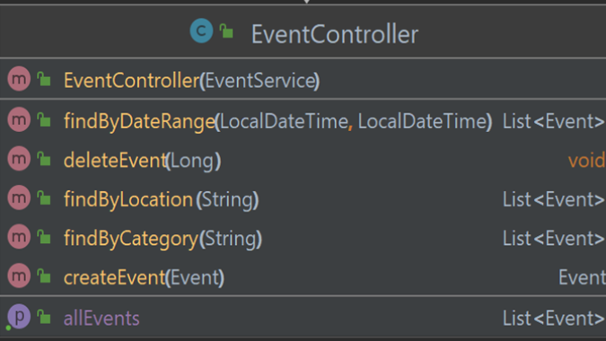
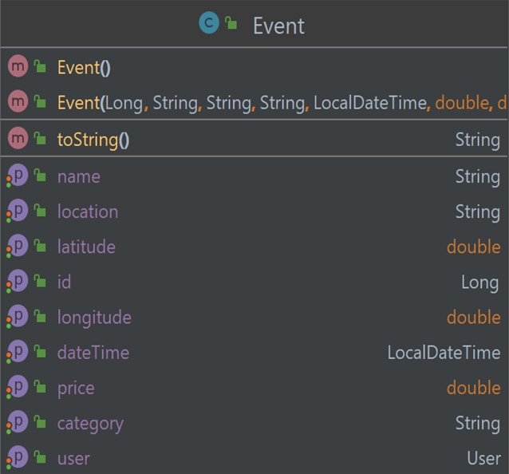
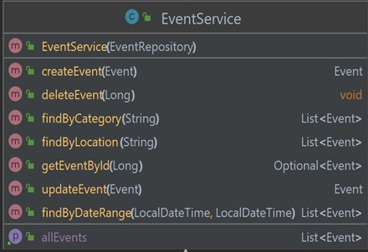
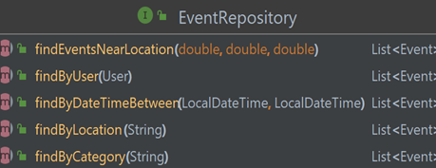
Classes and Interfaces

Slide 6
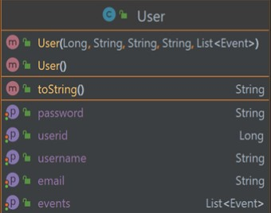
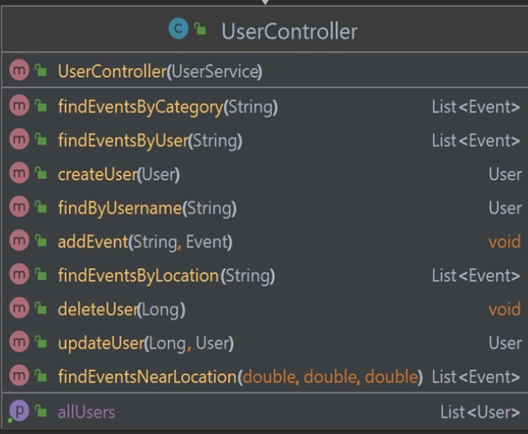
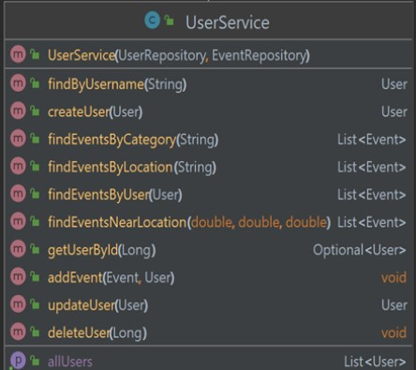
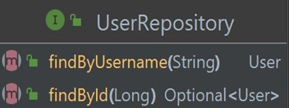
Classes and Interfaces

Slide 7
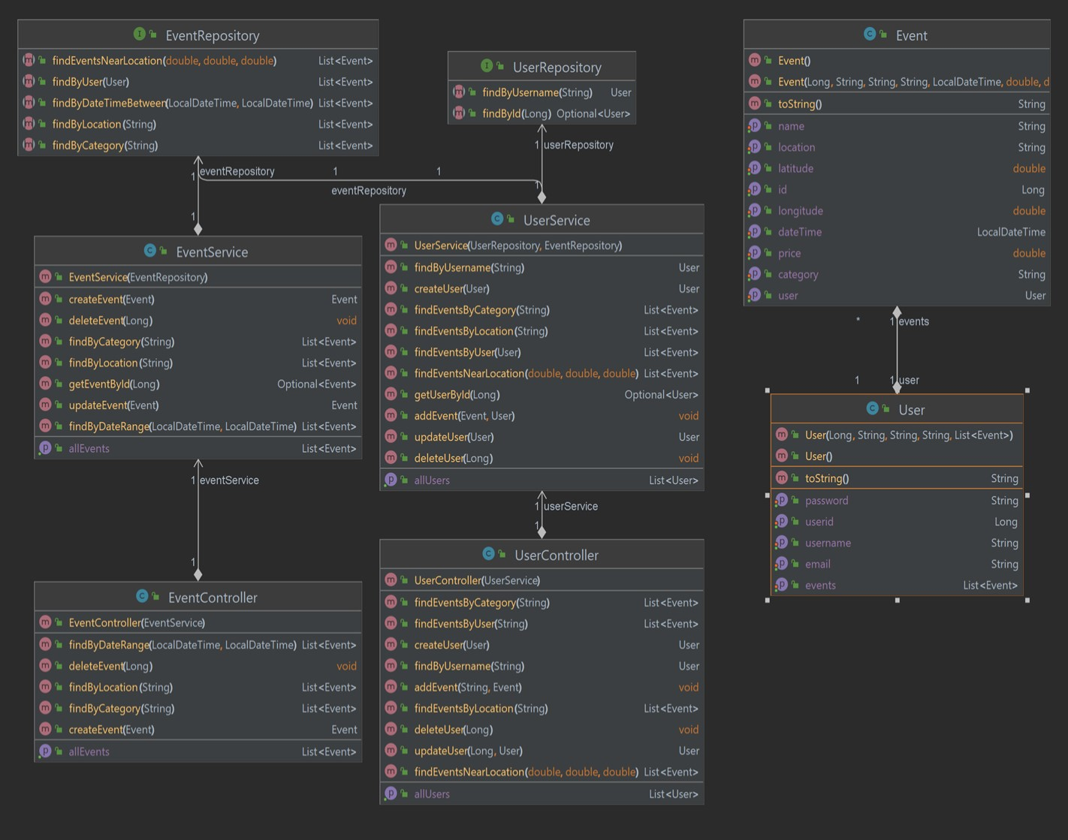
Class Diagram

Slide 8
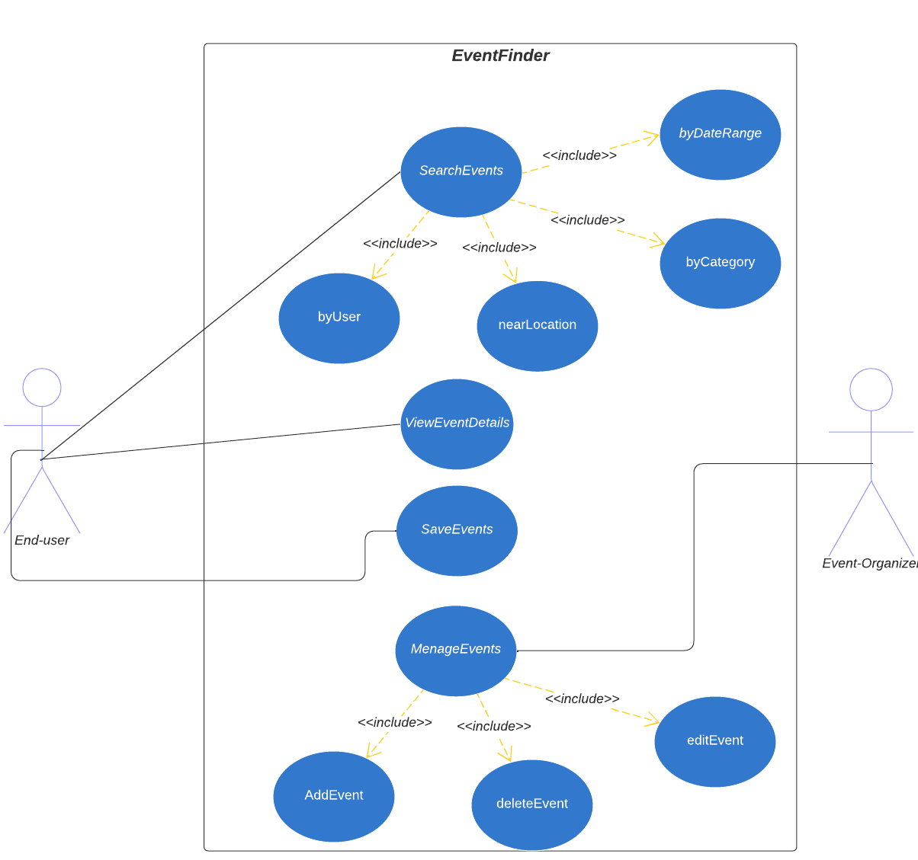
Use Case Diagram

Slide 9
Test Event
@Test
public void testEvent() {
User user = new User(1L, "John Doe", "johndoe@example.com", "password", null);
Event event = new Event(1L, "Music Festival", "Music", "New York", LocalDateTime.now(), 40.71, 74.00, 100.00, user);
assertNotNull(event);
assertEquals(1L, event.getId().longValue());
assertEquals("Music Festival", event.getName());
assertEquals("Music", event.getCategory());
assertEquals("New York", event.getLocation());
assertEquals(100.00, event.getPrice(), 0);
assertEquals(user, event.getUser());
}
This test checks the functionality of the User class.
The test creates a User object with specific values for its properties (userid, username, email, password, and events). Then, using JUnit's assertNotNull method, the test confirms that the object has been created successfully. The test also uses assertEquals methods to verify that the properties of the User object have the expected values.
The test also confirms that the events property is null. If any of the assertions fail, the test will result in a failure.

Slide 10
Test User
@Test
public void testUser() {
User user = new User(1L, "John Doe", "johndoe@example.com", "password", null);
assertNotNull(user);
assertEquals(1L, user.getUserid().longValue());
assertEquals("John Doe", user.getUsername());
assertEquals("johndoe@example.com", user.getEmail());
assertEquals("password", user.getPassword());
assertNull(user.getEvents());
}
This test method is testing the creation and properties of a User object in a Java Spring Boot application. The code first creates a new User object with specified parameters.
Then, it uses JUnit's assertNotNull method to ensure that the object is not null.
The code then uses JUnit's assertEquals method to check if the object's properties (userid, username, email, password, and events) are equal to the expected values. The first assertEquals method checks if the userid property is equal to 1, the second checks if the username property is equal to "John Doe", the third checks if the email property is equal to "johndoe@example.com", the fourth checks if the password property is equal to "password", and the fifth checks if the events property is equal to null...

Slide 11



User Stories
As an event attendee, I want to be able to search for events near my location, so that I can easily find events that I am interested in attending.
As an event organizer, I want to be able to create and manage my events, so that I can easily promote them to potential attendees.
As an event attendee, I want to be able to view event details, such as date, time, location, and ticket availability, so that I can plan my schedule and make informed decisions about which events to attend.

Slide 12
THANK YOU!
Isra Zeqiri
Agnesa Kriezi
Zana Ramuko

